Slide 1
FreeRTOS Fundamentals
Siddu G

Slide 2
Why FreeRTOS?
Trusted Kernel: With proven robustness, tiny footprint and wide device support, the freeRTOS supported by world-leading companies
Accelerate time to Market: Project setup easy with lot of demos available
Broad ecosystem support: Support to IDE setup for FreeRTOS and professional support for RTOS support
Features of FreeRTOS
Tiny, Power-saving kernel
Scalable size, program memory footprint is as low as 9KB
Support 40+ Architecture
Supports one code base – 40+ MCU Architectures including latest RISC-V and ARMv8-M (ARM Cortex – M33)
Modular Libraries
Modern library support including cloud connectivity
AWS reference integrations
Supports libraries to connect to cloud
MIT Licensed with options
FreeRTOS can be used under MIT license

Slide 3
RTOS Basics
The kernel is core component within operating system
Multiple users can execute multiple programs apparently concurrently
Each executing program is task(or thread) under control of the OS
If OS can execute more than one task at same time - Multitasking
Enables executing complex & large programs into smaller tasks in parallel
Multitasking
Advantages
Testing will be easy for partitioned tasks
Testing will be easy for partitioned tasks

Slide 4
Task Basics
A real time application can be converted to multiple independent RTOS tasks to perform specific task
Each task executes at its own context with no dependency between other tasks
Only one task within application can execute at single instance of time
The task RTOS schedular responsible for deciding which task needs to be run
The task will not have any idea about Schedular activity
It is responsibility of Schedular to ensure proper process context (register values, stack contents etc) when task gets swapped
To achieve task switching/process context – each task will have its own stack
When task switching/context happens – storing & restoring of task stack is Schedular responsibility
Each task maintains its own stack resulting in higher RAM usage
Re-entrancy must be carefully considered if using preemption

Slide 5
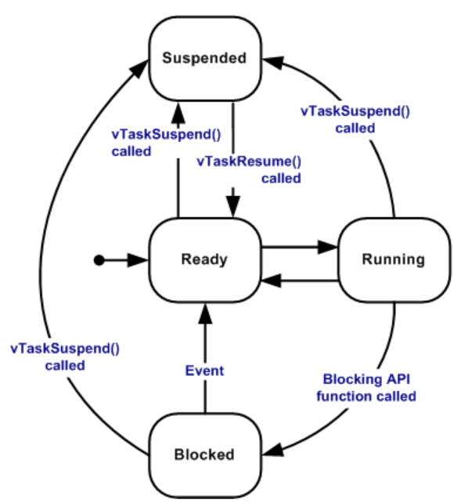
Task Basics continued …
At any point of time – task can be Ready, Running, Blocked or Suspended state
Task ready to execute but not currently executing because different task with equal priority or higher priority are in running state
Ready
Task is running and utilizing the processor time..If processor having single core, then only one task can execute at time
Running
Task will be blocked means not executing currently, it will be waiting for temporal or external event.. Task can wait for Queue, Semaphore, event, notification, semaphore event etc.. Tasks in blocked will have timeout
Blocked
Task in suspended state can’t enter Running state. Suspended tasks will not have timeout
Suspended

Slide 6
Task Basics continued …
Task Schedular
Task Priority
By Default, freeRTOS uses fixed-priority preemptive scheduling policy and round robin for equal priority tasks
Fixed priority – It means priority will never change during execution, but it may boost due to priority inheritance
“Preemptive” – Schedular always runs higher priority task at first then lower priority task
There can be “Task starvation” kind of issues if always higher priority tasks always runs, the lower priority task gets starved due to unavailability of processor time.. To avoid this issue, it is better to design task creation with event driven
As soon as event received – higher priority task gets executed from blocked state & while higher priority in blocked state, the lower priority tasks can run
If the value of configUSE_PREEMPTION is set to 0 means tasks context switch happens only when running tasks enters blocked or suspended state
If the value of configUSE_TIME_SLICING is set to 0 means time slicing is off, so schedular never switch between equal priority tasks on each tick interrupt
Each task got its own priority from 0 to configMAX_PRIORITIES – 1 - where configMAX_PRIORITIES is defined within FreeRTOSConfig.h
The maximum priority can be 32
Low priority numbers denote low priority tasks
The FreeRTOS scheduler ensures that tasks in the Ready or Running state will always be given processor (CPU) time in preference to tasks of a lower priority that are also in the ready state
If configUSE_TIME_SLICING is not defined - Any number of tasks can share the same priority
if configUSE_TIME_SLICING is set to 1 - Ready state tasks of equal priority will share the available processing time using a time sliced round robin scheduling scheme

Slide 7
Task Basics continued …
Task parameter | Description
configUSE_PREEMPTION | 1 - > Use pre

Slide 8
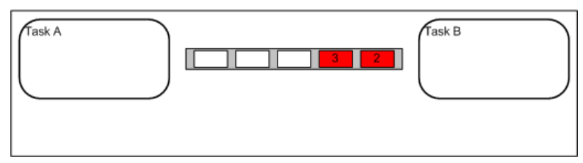
Queue
Queues are primary form of intertask communication
They can be used to send messages between tasks, and between interrupts and tasks
They are used as thread safe FIFO (First In First Out) buffers with new data being sent to the back of the queue

